Slide 1
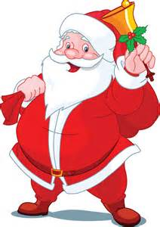
Santa Claus: A Phony!
Winston Frick

Slide 2
Disclaimer
*There is no such thing as magic, and we assume only realistic assumptions
The Christmas Holiday referred to is the Christian Holiday celebrated on December 25th.

Slide 3
Background information
Santa Claus, otherwise known as “St. Nick”, is an urban legend that claims for every child that’s on the nice list, Santa delivers presents to them on Christmas Eve/ Christmas morning. Every child that is on the naughty list receives coal from Santa.
Christmas is celebrated by Christians in the remembrance of the birth of Jesus Christ; however, in todays age, it has become a commercialized holiday where a lot of people still celebrate Christmas traditions.

Slide 4


Statistics
2.2 Billion Children in World. (Unicef)
Average of 3 children per home (hypertextbook)
32% of world celebrates Christmas (reindeerland)
It takes 6 liters of water to kill an 165 pound man (medical daily)

Slide 5
Definition
Santa Claus is a singular man who delivers presents and coal to children around the world in one night, on Christmas Eve (December 24) and into the early hours of Christmas Morning (December 25).

Slide 6


Proof
Prove Santa Claus is not real.

Slide 7
Proof
We prove by contradiction. Assume that Santa Claus is real.
If Santa was real, he would be able to deliver presents to every child residing on the nice list, and coal to every child on the naughty list.
By the statistics shown in the earlier slide, he would have to deliver to: (2.2 billion children/3 children per house hold) * 32% of world celebrating Christmas.
He would have to deliver to 234.67 million homes.

Slide 8
Contradiction 1
By urban legend, Santa climbs through the chimney, delivers presents and coal, eats the cookies, and drinks the milk.
Assuming this process takes a world record time of 3 seconds per house, this would be 3 seconds * 234.67 million houses = 704.01 million seconds. Or, 195,558 hours. Since he supposedly delivers everything in one night, the 195,558 hours exceeds this time frame because that allots to 8,148 days.
Thus, it is impossible for him to deliver presents in this time; therefore, Santa does not exist.

Slide 9
Contradiction 2
Since each home is supposed to put out milk and cookies, assume only 500,000 homes put out milk. If a cup of milk is equivalent to 8 ounces, this is equal to 4 million ounces of water, which is equivalent to 118,294 liters.
If it takes 6 liters to kill an 165 pound man, assuming Santa half of the milk, this amount of liquid would not be able to be consumed by anyone. (59,147 liters)
Thus, by contradiction, Santa would not be alive and would not able to keep delivering presents, contradicting the fact that he is real.

Slide 10

Conclusion of Proof
By either of these three contradictions, it is apparent that Santa could not deliver these presents in one night.
Since people claim Santa does deliver these presents, and it’s impossible for him to do so, Santa must not exist.
Must be someone else delivering presents!

Slide 11

Flaws in “The Science of Christmas”
Showing flaws in the logic behind the following article and the statistics behind it.
This article attempts to prove that Santa is not real; however, uses some flawed arguments, therefore making the proof invalid.

Slide 12
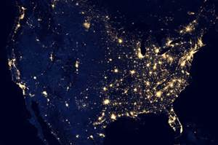
Assumption 1
The first major flaw is in the assumption that each household is distributed evenly around the world. While this might make it easier to prove, this is a highly illogical assumption as we know population is mostly in condensed cities, and the cities are spread out by large distances.
For example, the US population is largely spread out. And this occurs around the world.

Slide 13
Assumption 2
The article claims Santa has a 32 hour window to deliver presents because he has a full 24 hours if he’s spanning across the Earth, plus the 8 hours children are sleeping.
This number is highly illogical because a number of reasons.

Slide 14
Assumption 2
First, Santa has one night to deliver presents, so it is counter intuitive to assume he has more than 24 hours to deliver. This flaw comes in the fact of adding an additional 8 hours to the 24 hour time period because of children sleeping; however, this “additional” 8 hours occurs during the 24 hour time period.
Second, population is distributed unevenly, so he has only a certain amount of time in each time zone. He cannot spend equal time in an unpopulated time zone than he would in a densely populated time zone, or he would run out of time.

Slide 15
Assumption 3
The article claims each house is, on average, 1.47km apart. First, this number is illogical because of the unevenly distributed houses, and they didn’t classify which actual houses celebrated Christmas. Second, they calculate this number because they assume the world is flat.
This is a highly illogical assumption because it is much faster to travel around a globe than a map. For example, it is much faster to travel from USA to Asia by flying North over Alaska, then a straight line route because the circumference of the Earth is much larger near the equator than near the poles. This effect does not exist on a flat surface.

Slide 16

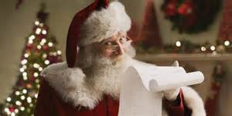
Conclusion
By the following proof, and the flawed assumptions by telegraph.co.uk, it is evident that Santa Claus is not real. It is physically impossible for him to deliver all these presents and coal in one night.

